Slide 1
Artificial Intelligence in Science Fiction

Slide 2
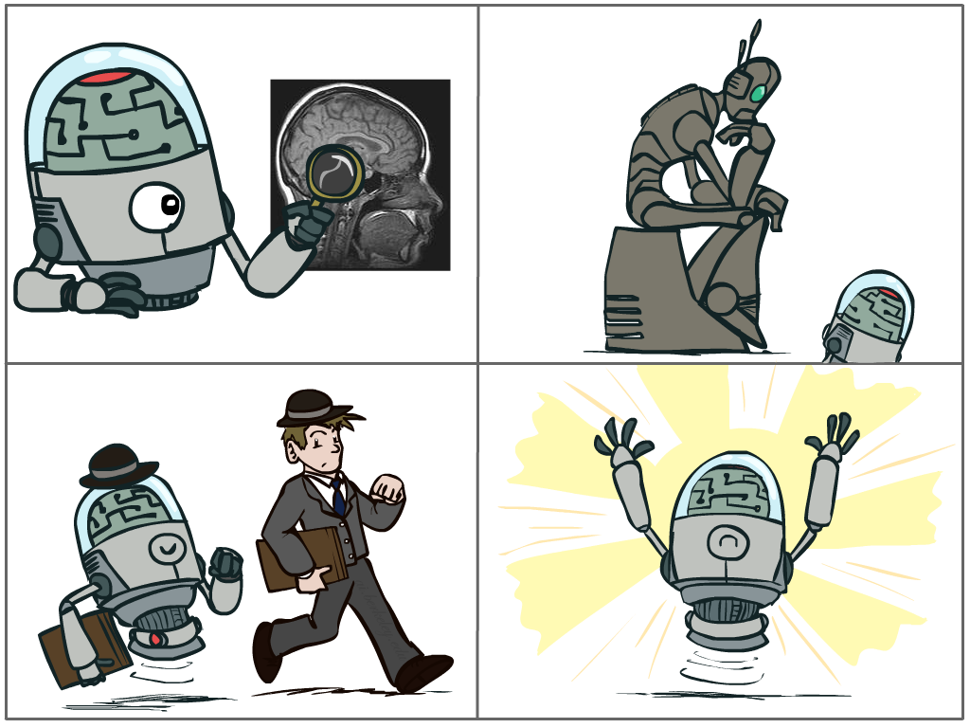
What is AI?
The science of making machines that:
Think like people
Think rationally
Act like people
Act rationally
Slide from Dan Klein and Pieter Abbeel of UC Berkeley
Notes:
Top left: Think like people --- cognitive science, neuroscience
Bottom left: act like people --- actually very early definition, dating back to Alan Turing --- Turing test; problem to do really well you start focusing on things like don’t answer too quickly what the square root of 1412 is, don’t spell too well, and make sure you have a favorite movie etc. So it wasn’t really leading us to build intelligence
Think rationally – long tradition dating back to Aristotle --- but not a winner, because difficult to encode how to think, and in the end it’s not about how you think, it’s about how you end up acting

Slide 3
AI in SciFi - Acting Human

Slide 4

AI in SciFi - Acting Human

Slide 5
AI in SciFi - Acting Human

Slide 6
AI in SciFi - Acting Human

Slide 7
Blade Runner - Voight-Kampff Test
https://www.youtube.com/watch?v=Umc9ezAyJv0
Notes:
2:45 seconds

Slide 8
Descartes Deckard

Slide 9
Science Fiction and Science Fact
https://www.youtube.com/watch?v=JknRYYrV5Vk

Slide 10
Science Fiction and Science Fact
Notes:
Computer vision - https://research.fb.com/learning-to-segment/

Slide 11
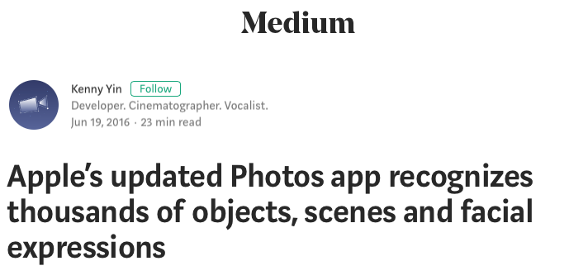
Armchair, Armchairs, Art, Artistic Creation, Artistic Creations, Artistries, Artistry, Arts, Artwork, Artworks, Arthropods, Arthropod, Arthropods, Artichoke, Artichokes, Arugula, Arugulas, Garden Rocket, Garden Rockets, Rocket Salad, Rocket Salads, Roquette, Roquettes, Asparagus, Asparaguses, ATM, ATMs, Automated Teller, Automated Teller Machine, Automated Teller Machines, Automated Tellers, Automatic Teller, Automatic Teller Machine, Automatic Teller Machines, Automatic Tellers, Cash Dispenser, Cash Dispensers, Cash Machine, Cash Machines, ATV, ATVs, All Terrain Vehicle, All Terrain Vehicles, Auditorium, Amphitheater, Amphitheaters, Auditoriums, Concert Hall, Concert Halls, Music Hall, Music Halls, Aurora, Auroras, Australian Shepherd, Australian Shepherds, Automobile, Auto, Automobiles, Autos, Car, Cars, Motorcar, Motorcars, Avocado, Aguacate, Aguacates, Alligator Pear, Alligator Pears, Avocados, Axe, Ax, Axes, Baby, Babe, Babes, Babies, Infant, Infants
Science Fiction and Science Fact
Notes:
https://medium.com/@iosight/behind-apples-advanced-computer-vision-for-photos-app-41f3f617d31c

Slide 12
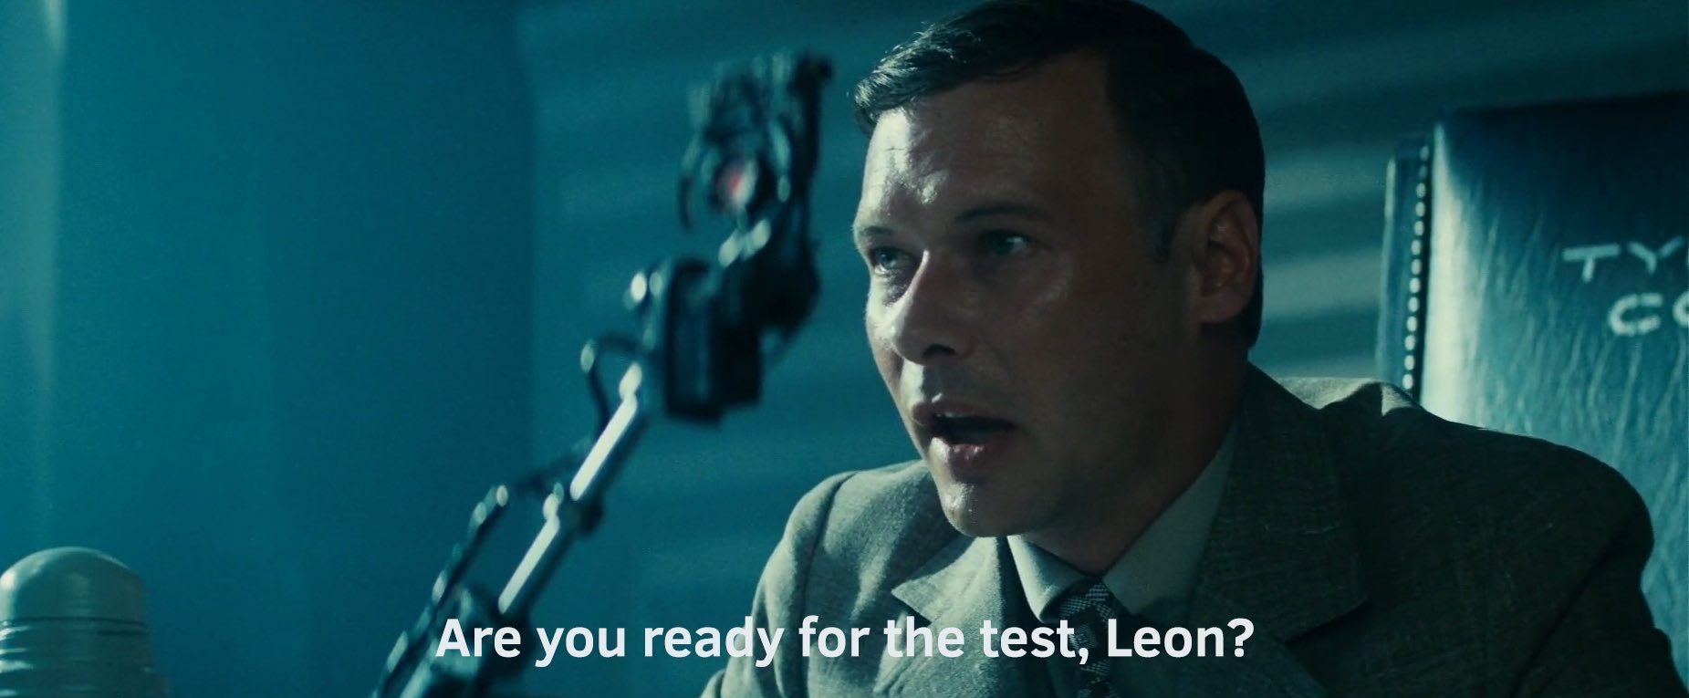
Science Fiction and Science Fact

Slide 13
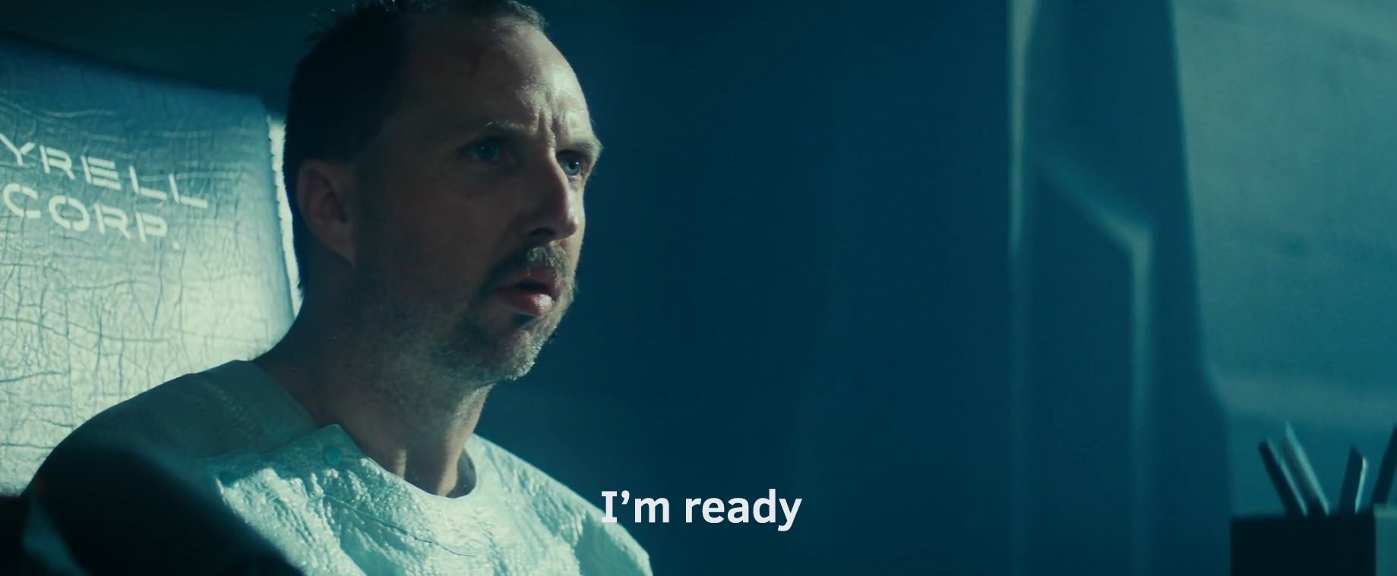
Science Fiction and Science Fact

Slide 14
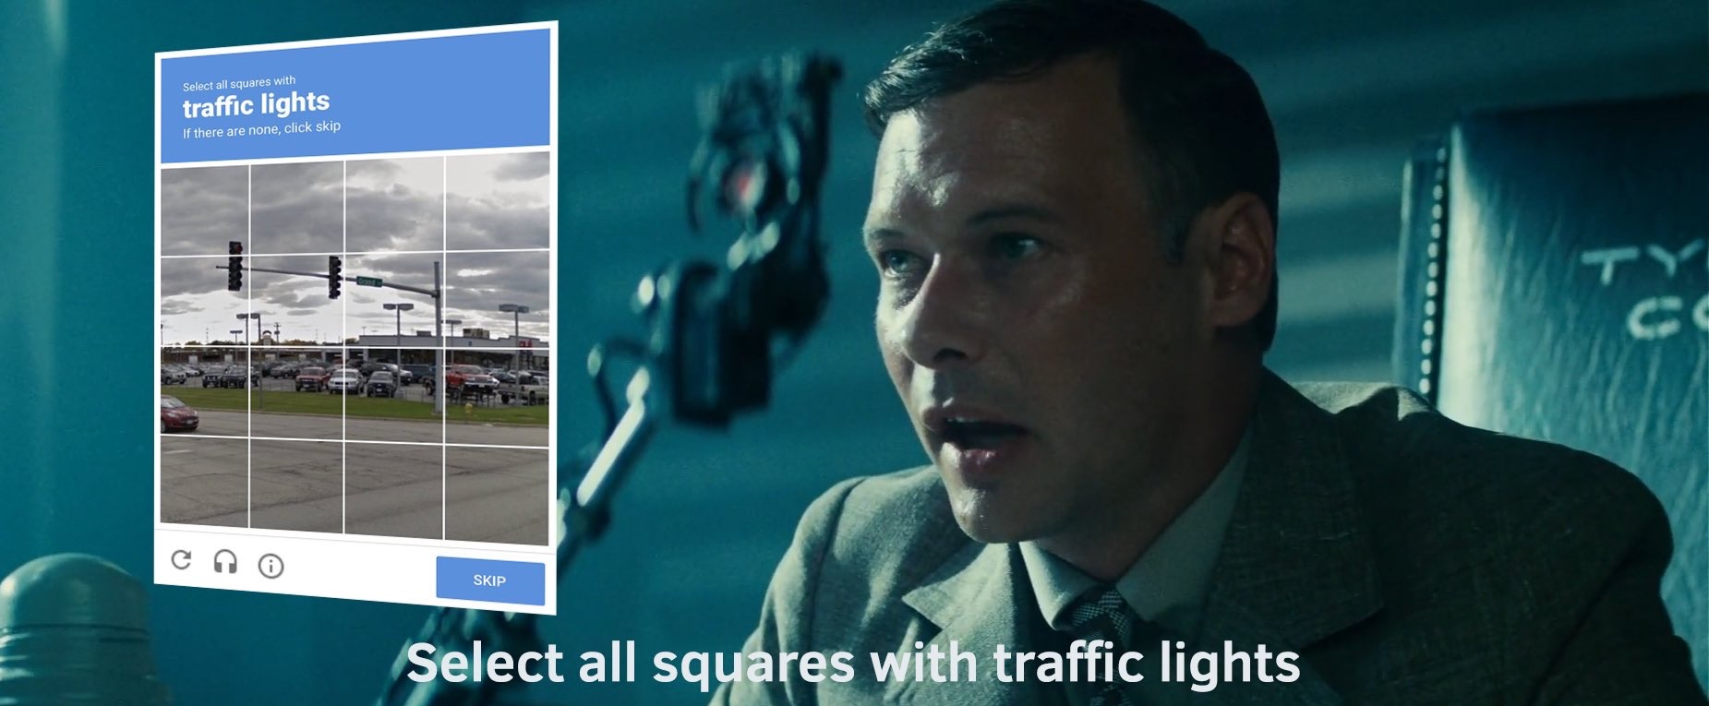
Science Fiction and Science Fact

Slide 15
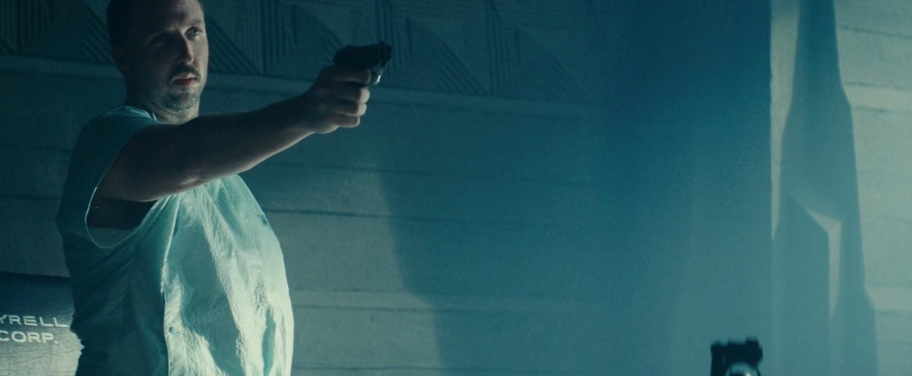
Science Fiction and Science Fact
Joke Credit: James Dennis

Slide 16
Science Fiction and Science Fact
https://www.youtube.com/watch?v=s93KC4AGKnY

Slide 17
Science Fiction and Science Fact
Notes:
Kasparov v. Deep Blue in 1997

Slide 18
Science Fiction and Science Fact
Notes:
Ken Jennings v. IBM Watson in 2013

Slide 19
Science Fiction and Science Fact
Notes:
Grandmaster Lee Sedol versus Google DeepMind Alpha Go in 2016

Slide 20
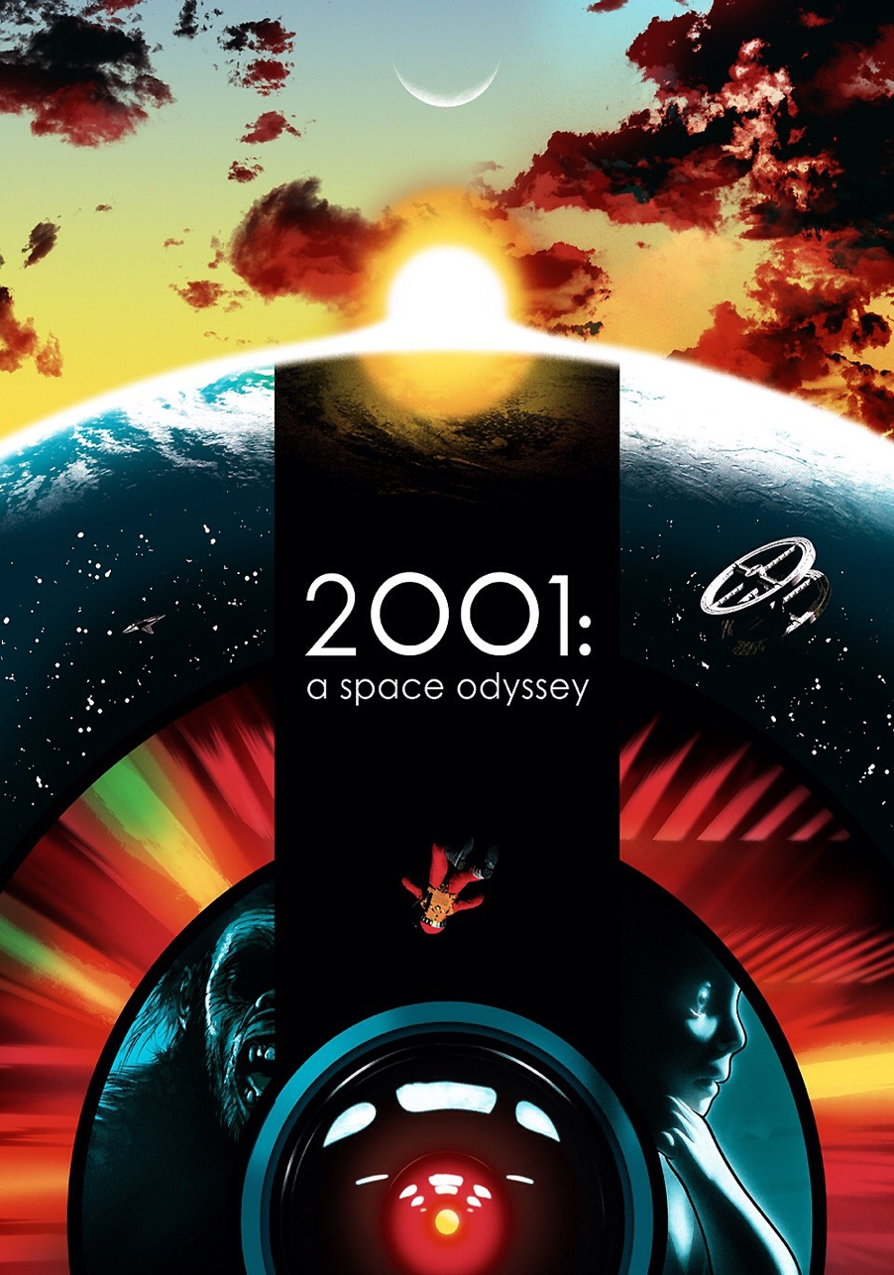
Science Fiction and Science Fact
https://www.youtube.com/watch?v=Lk8qgMFqaY8
Notes:
HAL = letters for IBM decremented by 1

Slide 27
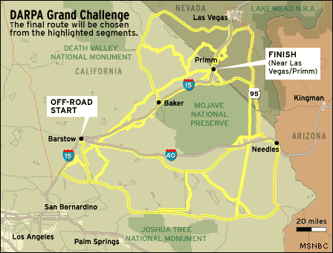
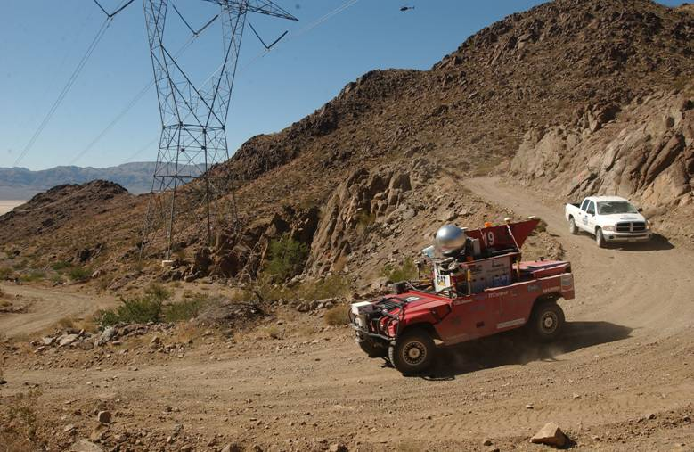
Science Fiction and Science Fact
DARPA Grand Challenge 2005
Notes:
1st time 2004: 7 miles
2nd time: 132 mile
5 completed: Stanford: just under 7 hrs.
Oshkosh Truck (huge armored truck) 13 hrs.

Slide 28
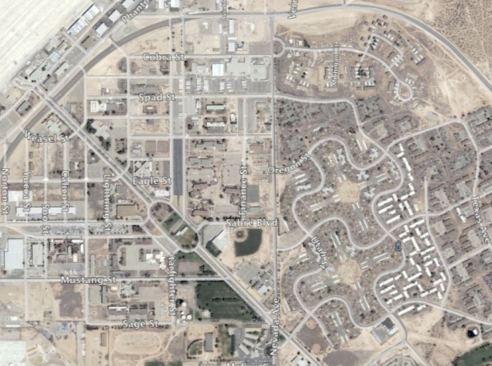
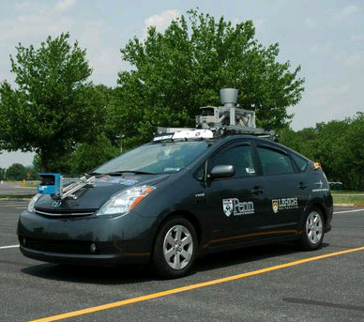
Science Fiction and Science Fact
DARPA Urban Challenge 2007
Notes:
Penn – 1 of 6 to finish. Tartan won -14mph average

Slide 29
Science Fiction and Science Fact
DARPA Robotics Challenge 2015
https://www.youtube.com/watch?v=g0TaYhjpOfo
Notes:
Penn – 1 of 6 to finish. Tartan won -14mph average

Slide 30
Science Fiction and Science Fact
Boston Dynamics Atlas 2016
https://www.youtube.com/watch?v=M91ISnATDQY
Notes:
Penn – 1 of 6 to finish. Tartan won -14mph average

Slide 31
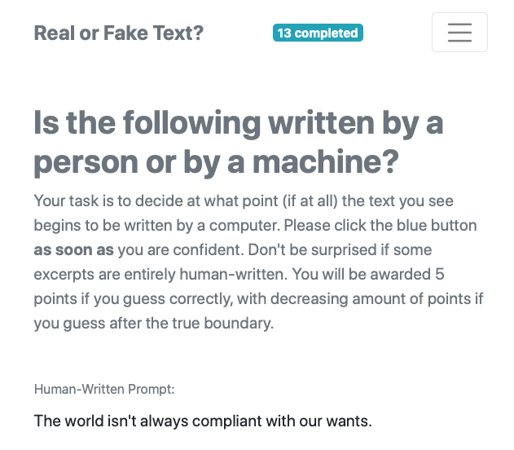
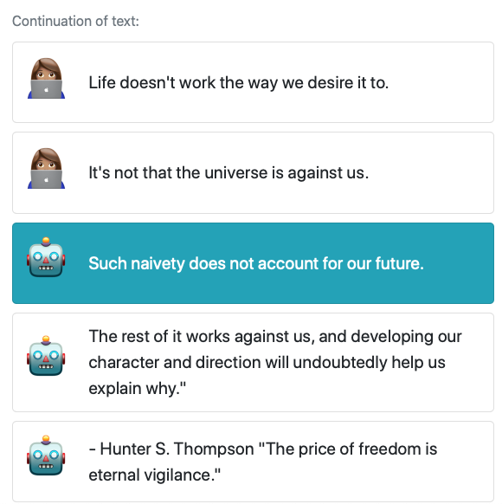
https://roft.io/
For Fun: Try a Turning Test from my PhD students

Slide 32
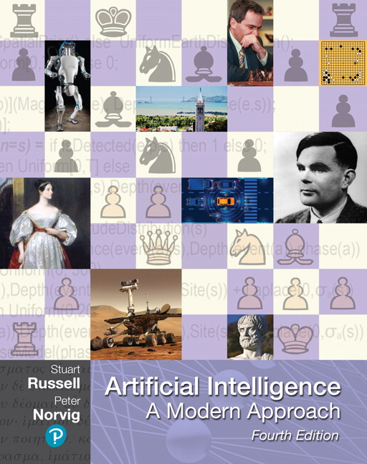
HW: Read Chapter 1 & 27
Please read:
Chapter 1, Section 1.1
Chapter 27.1 and 27.2 of the textbook.
The required readings will be posted on the course website in the schedule tab.
http://artificial-intelligence-class.org/
The website will have all lecture recordings, homework assignments, and course policies.

Slide 33

On your own:
A Brief Introduction to Python
The first Python programming HW has been released. Find it on the course Canvas.
Notes:
That would be over 1000 pages.

